Slide 1

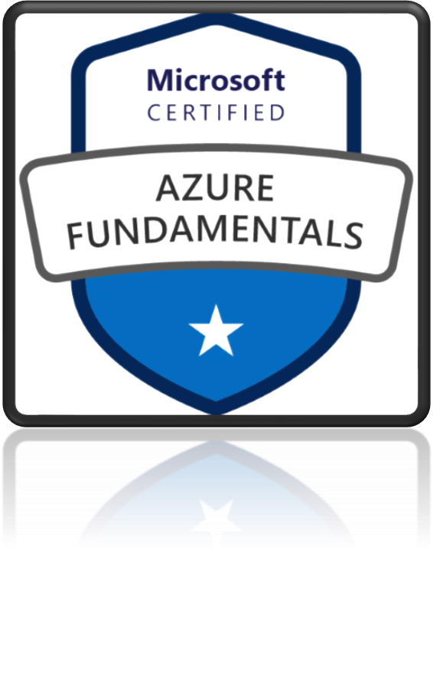
AZ-900
Microsoft Azure Fundamentals

Slide 2
Cloud fundamental concepts
In this module, you will learn that how cloud computing will save your company time and money by migrating from your existing, on-premises, physical hardware, to a cloud solution.
You’ll also learn about the fundamental concepts of cloud computing, how Azure implements these concepts,
High availability, Fault tolerance and Disaster recovery
Scalability, Elasticity, and Agility
CapEx vs OpEx
Learning Objectives
Economic benefits of the cloud
Consumption-based model
Computing Models
Categories of cloud services - SaaS vs PaaS vs IaaS
Deployment Models
Types of Cloud Computing - Public, Private and Hybrid
Cloud Pricing Model

Slide 3
Scalability, Elasticity, and Agility
Benefits of using the cloud

Slide 4
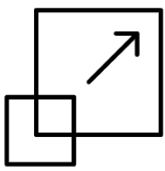
Scalability
Resources cost money
Charged for diskspace, CPU, memory, bandwidth Minimize cost by minimizing resources used
▪
Resource needs change quickly
Resource demand can fluctuate based on
Particular day
Time of day
Increase in popularity
Scalable architectures provide the ability to grow your environment when this is needed (increase in number of users, traffic throughput)
Example: Workload increased as business expanded over a period of time
Two types of Scalability:
Vertical Scalability
Horizontal Scalability
▪

Slide 5

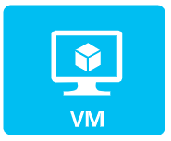
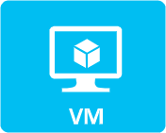


Vertical Scalability
Bachelor
No experience
Master Some experience
PhD
Good experience
POSTDOC
Lot of experience
Increasing a capacity of current server: A larger hard drive, A faster CPU, More RAM, CPU, I/O, or networking capabilities
Has Limits
Horizontal Scalability
Bachelor
Bachelors
Deploying multiple instances of application/database
Increases availability
Horizontal Scaling needs additional infrastructure: Load Balancers, auto scaling group etc.

Slide 6
Scalability vs Elasticity
Scalable architectures provide the ability to grow your environment when this is needed (increase in number of users, traffic throughput)
Example: Workload increased as business expanded over a period of time
Two types of Scalability:
Vertical Scalability
Horizontal Scalability
Elasticity: Ability to automatically expand or compressed the infrastructural resources on a sudden-up and down in the requirement so that the workload can be managed efficiently.
Example: workload increases during festive season like Christmas.
Elasticity
Scalability
Elasticity is used just to meet the sudden up and down in the workload for a small period of time.
Scalability is used to meet the static increase in the workload.
Elasticity is used to meet dynamic changes, where the resources need can increase or decrease.
Scalability is always used to address the increase in workload in an organization.
It is a short term planning and adopted just to deal with an unexpected increase in demand or seasonal demands.
Scalability is a long term planning and adopted just to deal with an expected increase in demand.

Slide 7
Agility
Agility: Rapidly deploy and configure cloud resources as your app's needs change.
Speed and flexibility of scaling in the cloud
39

Slide 8
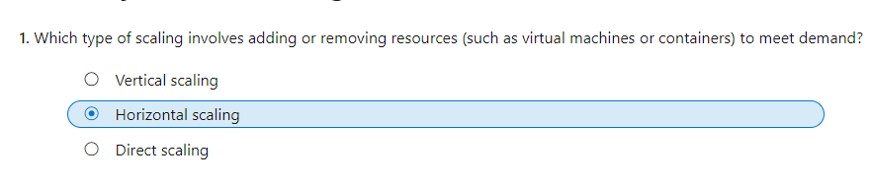

Slide 9
CapEx vs OpEx
Capital Expenditure (CapEx) vs Operational Expenditure (OpEx)

Slide 10
CapEx vs OpEx
Capital Expenditure (CapEx)
Operational Expenditure (OpEx)
Upfront cost
Pay-as-you-go pricing
Spending money ahead on physical infrastructure and
There is no up-front cost, as you pay for a service or product as
then deducting that cost over time from your tax bill.
you use it.
Example: Deploying your own data center
Server, Storage , Network , Backup and archive ,
Pros: Demand and growth may be unexpected and exceed
estimates, posing a capex issue.
Disaster recovery, Datacenter infrastructure
Example: Cloud Services
Summary: CapEx requires significant up-front financial
Summary: OpEx is a consumption-based model, so company is
costs, as well as ongoing maintenance and support
only responsible for the cost of the computing resources that it
expenditures.
uses.
41

Slide 11

Benefits of the cloud computing

Slide 12

New Startup
Launching a new professional social network
At launch, the focus will be on the United States.
If the launch is a success, the company intends to expand globally.

Slide 13
Traditional Data Center Challenges
Large up-front investment
Forecast Infrastructure needs
Took 5 months to setup there server
Suddenly become popular
lot of users, experiencing latency
Scaling will need further few months of effort
Security and Compliance burden
Less Load during off season
Now, difficult to scale down
Maintenance cost still going on
Plan to Expand Globally
Same challenges again
44

Slide 14
Cloud Computing Benifits
Advantages of Cloud Computing
Traditional Data Center Challenges
Trade capital expense for variable expense
Large up-front investment
No Initial investment
Pay only for how much you use – do not own hardware
Forecast Infrastructure needs
Took 5 months to setup there server
Stop guessing capacity
You can access as much or as little capacity as you need, and scale up or down in minutes.
Suddenly become popular
lot of users, experiencing latency
Scaling will need further few months of effort
Security and Compliance burden
Increase speed and agility
New IT resources are only a click away
Reduce resource deployment time from weeks to minutes.
Less Load during off season
Now, difficult to scale down
Maintenance cost still going on
Benefit from massive economies of scale
Plan to Expand Globally
Same challenges again
AWS can aggregate usage from hundreds of thousands of customers, they can lower pay-per-use prices.
Stop spending money running and maintaining data centers
Go global in minutes: In just a few clicks, you can easily deploy your application to multiple regions worldwide.
45

Slide 15

Consumption-based model
pay-as-you-go model

Slide 16
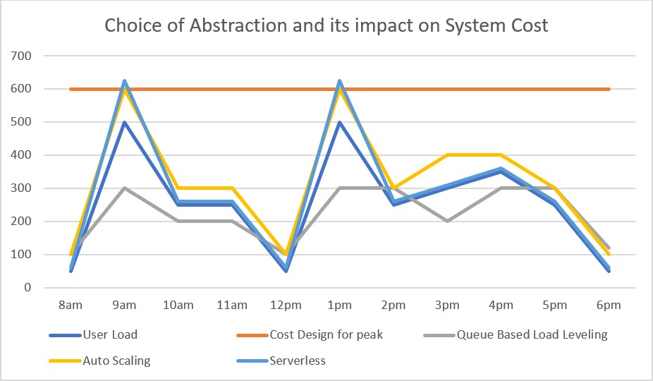
Consumption-based model vs fixed cost model
Cloud pricing model in which clients are only pay for the resources they utilize.
There are no upfront fees.
No need to buy and maintain expensive infrastructure
Pay just for what you need.
When you don’t need, don’t have to pay
47

Slide 17
Computing Models
Categories of cloud services - SaaS vs PaaS vs IaaS

Slide 18
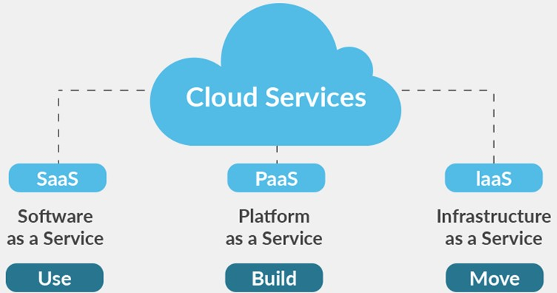
SaaS vs PaaS vs LaaS

Slide 19




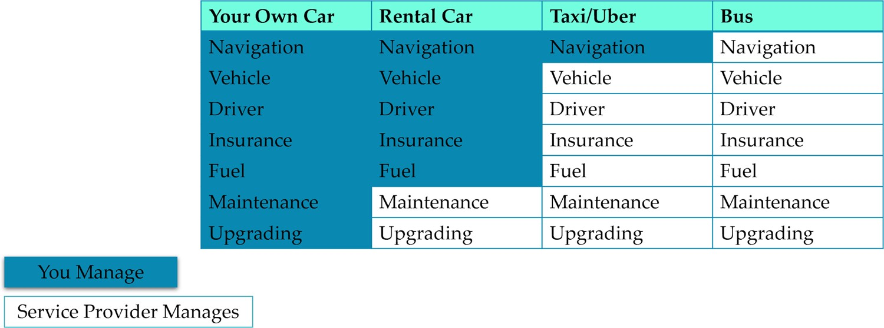
SaaS vs PaaS vs LaaS

Slide 20
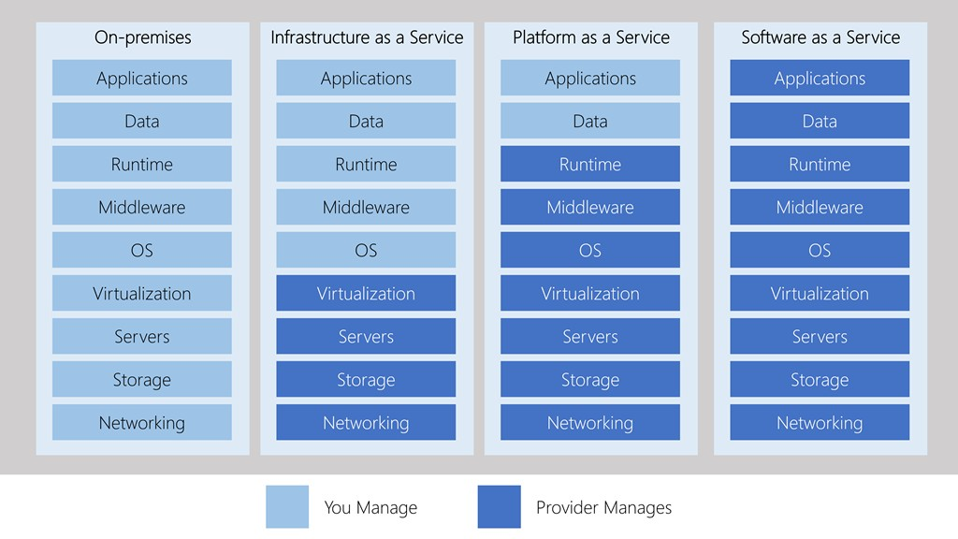
SaaS vs PaaS vs LaaS

Slide 21
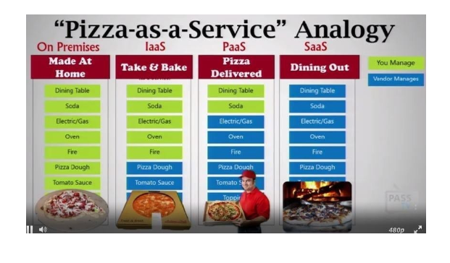
Computing Model - Pizza Analogy
Pretty good pizza analogy to understand IaaS vs PaaS vs SaaS

Slide 22
Infrastructure as a Service(IAAS)
IaaS stands for Infrastructure as a Service, which is a cloud computing service model that provides users with access to virtualized computing resources over the internet. With IaaS, users can rent computing infrastructure such as virtual machines, storage, and networking components from a cloud provider.
In IaaS, the cloud provider is responsible for managing the underlying hardware, including servers, storage, networking, and data center facilities. The user is responsible for managing the operating system, applications, and data.
Here are some examples of how IaaS is used:
Virtual machines: Users can rent virtual machines (VMs) from the cloud provider and configure them with the desired operating system, applications and data.
Storage: Users can rent storage space from the cloud provider, which can be used for data backup, archiving, and disaster recovery.
Networking: Users can rent networking components, such as firewalls, load balancers, and virtual private networks (VPNs) from the cloud provider.
Big data processing: IaaS can be used for big data processing, including running distributed computing frameworks such as Apache Hadoop or Apache Spark.
DevOps: IaaS can be used for continuous integration and continuous deployment (CI/CD) processes, allowing developers to create and deploy applications in a more agile and automated way.

Slide 23
Platform as a Service(PAAS)
PaaS stands for Platform as a Service, which is a cloud computing service model that provides users with a platform for building, deploying, and managing applications without the need to manage the underlying infrastructure. With PaaS, the cloud provider manages the underlying infrastructure, including servers, storage, and networking, while the user is responsible for managing the applications and data.
Here are some examples of how PaaS is used:
Application development: PaaS provides a platform for developing and testing applications without worrying about the underlying infrastructure. The provider takes care of the hardware and software required to run the application, allowing developers to focus on the application itself.
Web hosting: PaaS can be used to host web applications and websites. The provider takes care of the infrastructure, including servers, storage, and networking, allowing the user to focus on the application.
Database management: PaaS can provide a platform for managing databases, including configuration, backups, and scaling.
Mobile application development: PaaS can provide a platform for building and deploying mobile applications. The provider takes care of the infrastructure, allowing developers to focus on building the application.
Internet of Things (IoT): PaaS can be used to provide a platform for building and deploying IoT applications, such as data collection, analysis, and visualization. The provider manages the infrastructure and scaling, allowing users to focus on the application.
In summary, PaaS provides a platform for building, deploying, and managing applications, without the need to manage the underlying infrastructure. This can reduce development time and costs, while increasing scalability and reliability.

Slide 24
Software as a Service(SAAS)
SaaS stands for Software as a Service, which is a cloud computing service model that provides users with access to software applications over the internet. With SaaS, users do not need to install, maintain or manage software applications on their own devices or servers. Instead, the software is hosted and managed by the cloud provider, and users can access it from anywhere with an internet connection.
Here are some examples of how SaaS is used:
Customer Relationship Management (CRM): SaaS can provide users with access to CRM software, such as Salesforce, which allows businesses to manage customer interactions and relationships.
Email and collaboration: SaaS can provide users with access to email and collaboration software, such as Google Workspace or Microsoft Office 365, which allows users to share documents and collaborate on projects.
Human Resources (HR) management: SaaS can provide users with access to HR software, such as Workday or ADP, which allows businesses to manage employee information, payroll, and benefits.
Accounting and finance: SaaS can provide users with access to accounting and finance software, such as QuickBooks or Xero, which allows businesses to manage their finances and track expenses.
Project management: SaaS can provide users with access to project management software, such as Asana or Trello, which allows teams to manage tasks and projects.
In summary, SaaS provides users with access to software applications over the internet, without the need to install, maintain or manage the software on their own devices or servers. This can reduce costs and increase scalability, as users can access the software from anywhere with an internet connection.

